Slide 1
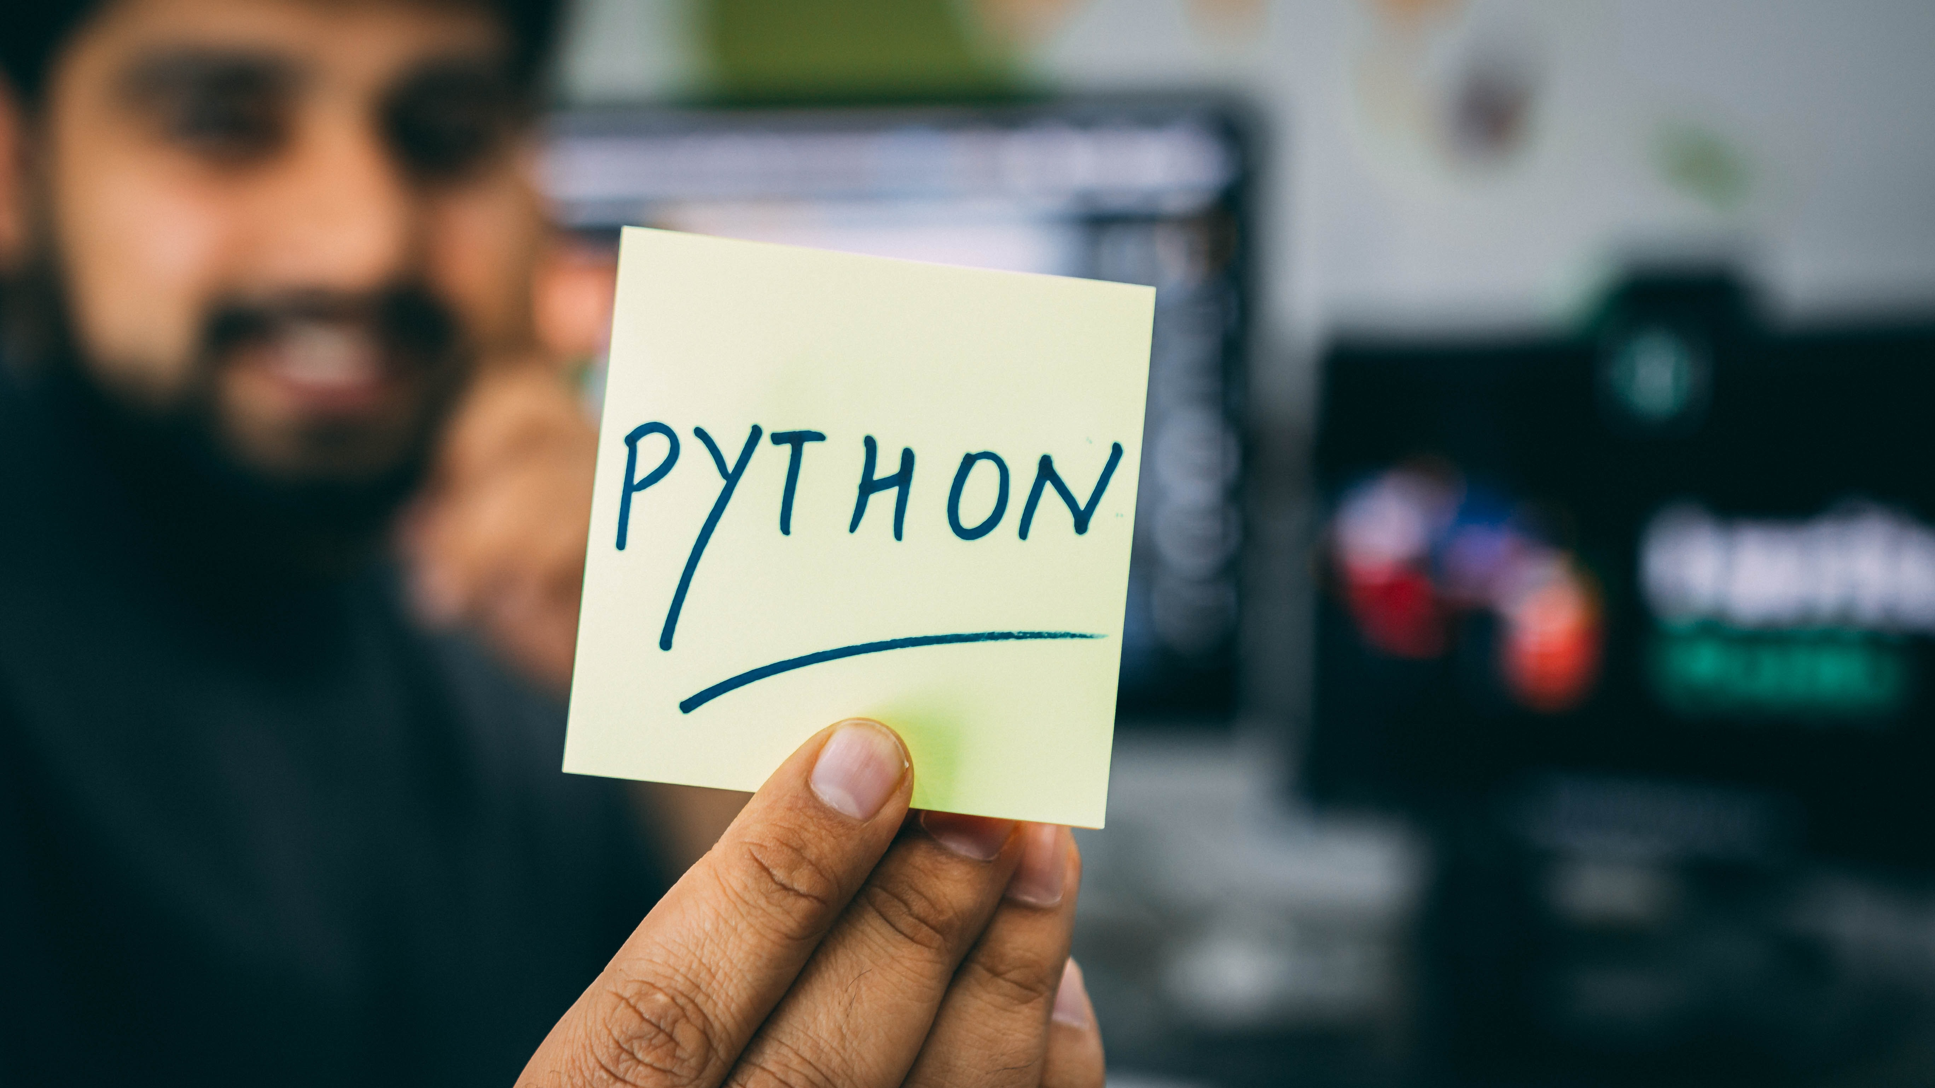
5 DAYS WITH PYTHON
DAY 5
Speaker : Krutika vinchu

Slide 2
What we learn today…
OOPS concepts - class, objects, Inheritance.
Functions
1
2
3
4
How to be a Python Developer?
File handling

Slide 3

functions

Slide 4

What is function?
Function is group of related statements that performs a specific task.
Functions make the code organized , reusable and manageable.
Types of Functions:
Built-in functions:
Functions that are built into Python.
User-Defined functions:
Functions defined by users.

Slide 5
Functions caling
In Python, after the function is created, we can call it from another function.
A function must be defined before the function call; otherwise, the Python interpreter gives an error.
To call the function, use the function name followed by the parentheses.

Slide 6
Built-in functions:
Input() function
print() function
Int() function
float() function
type() function

Slide 7
Input() function
Python input() function is used to get an input from the user.
It prompts for the user input and reads a line.
After reading data, it converts it into a string and returns it.
It throws an error EOFError if EOF is read.

Slide 8
print() Function
The python print() function prints the given object to the screen or other standard output devices.

Slide 9
int() function
Python int() function is used to get an integer value.

Slide 10
float() function
The python float() function returns a floating-point number from a number or string.

Slide 11
type() function
The python type() returns the type of the specified object if a single argument is passed to the type() built in function. If three arguments are passed, then it returns a new type object.

Slide 12

File Handling

Slide 13
File Handling

Slide 14



Why we need a File ??
File Handling
What if you want to the save data permanently??
Text
File
Permanent Storage
MySQL
=
Relational Database
=
Oracle

Slide 15
File Handling
open("file.txt", "x")
f = open
("D:\\file\\welcome.txt", "r")
print(f.read())
f = open
("demofile3.txt", "w")
f.write(“Deleted!")
Creating
import os
os.remove
("demofile.txt")
Reading
Updating
Deleting

Slide 16

Object Oriented Programing In Python

Slide 17

OOP in Python…
Procedure Oriented
1.Class
Python
1.Object
Functional Programing
Object Oriented

Slide 18
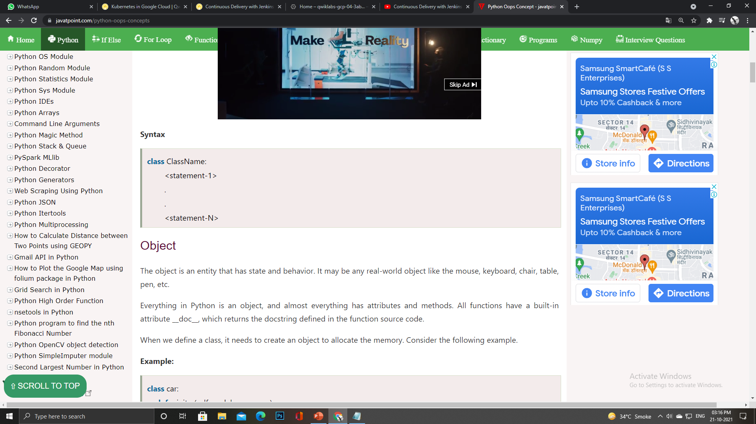
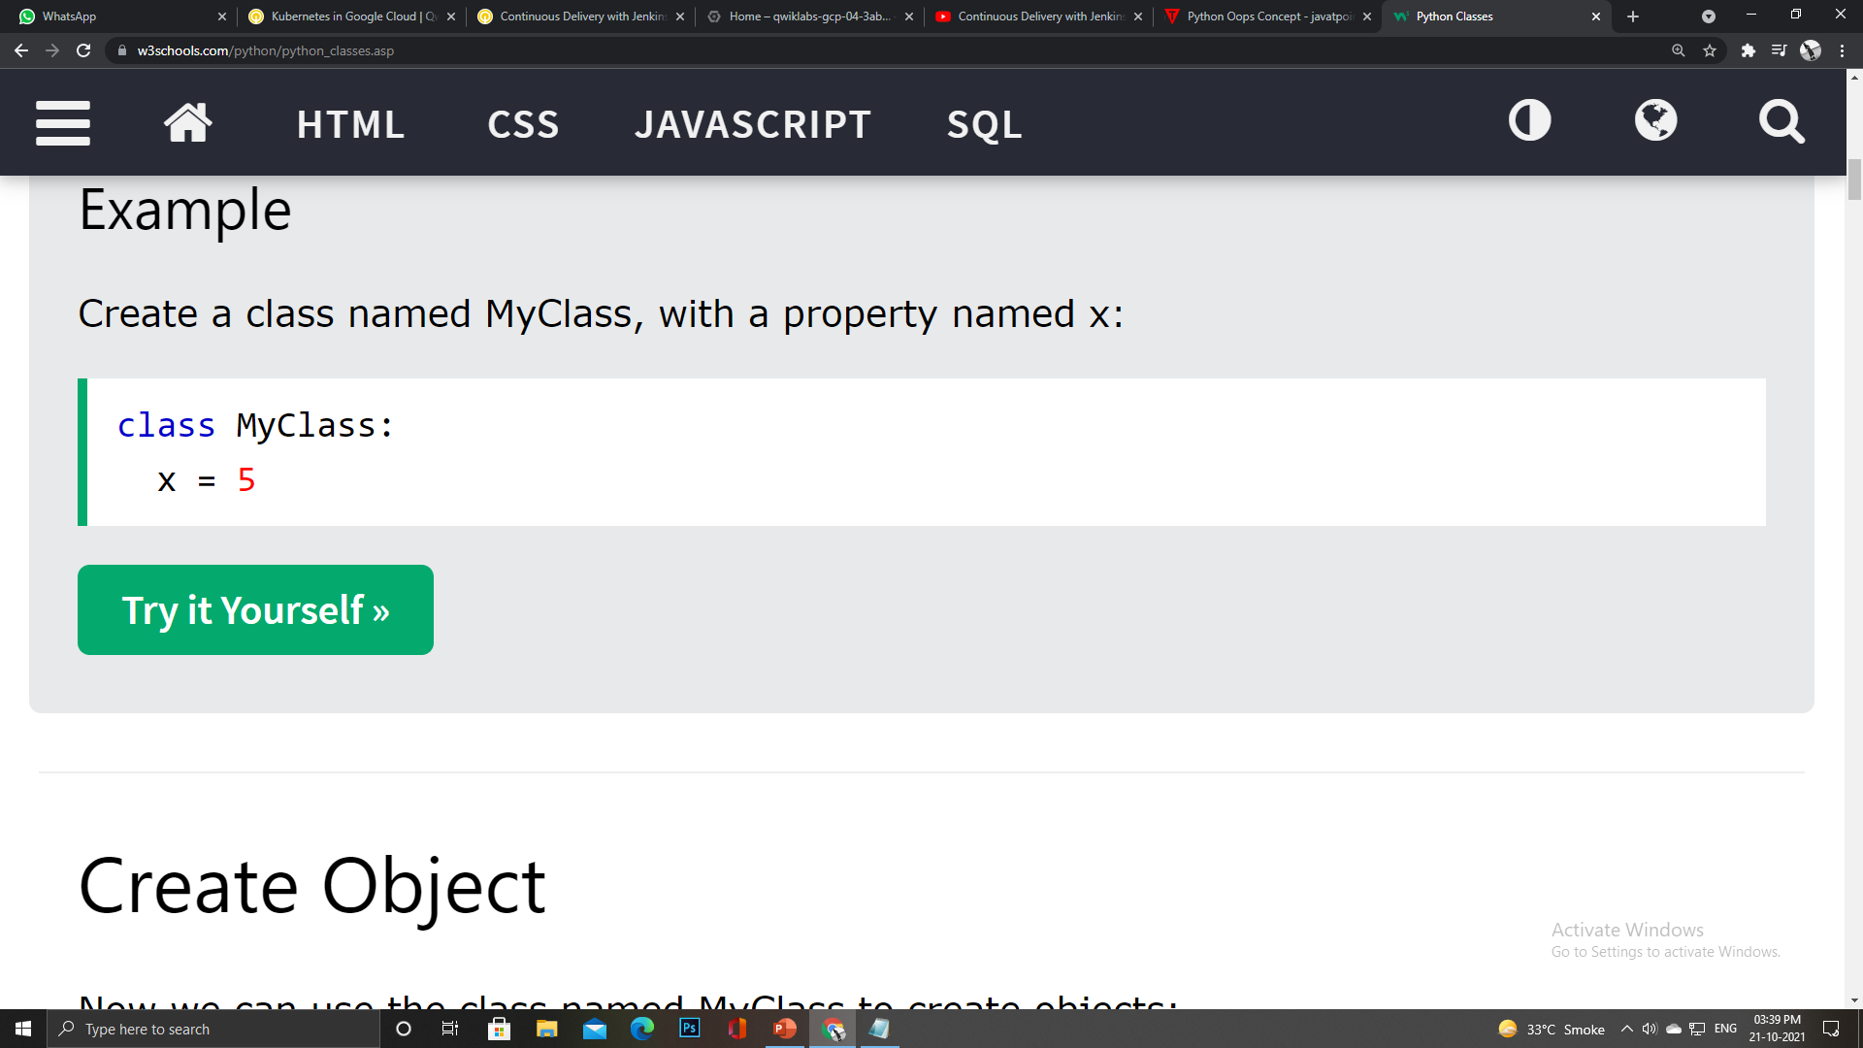
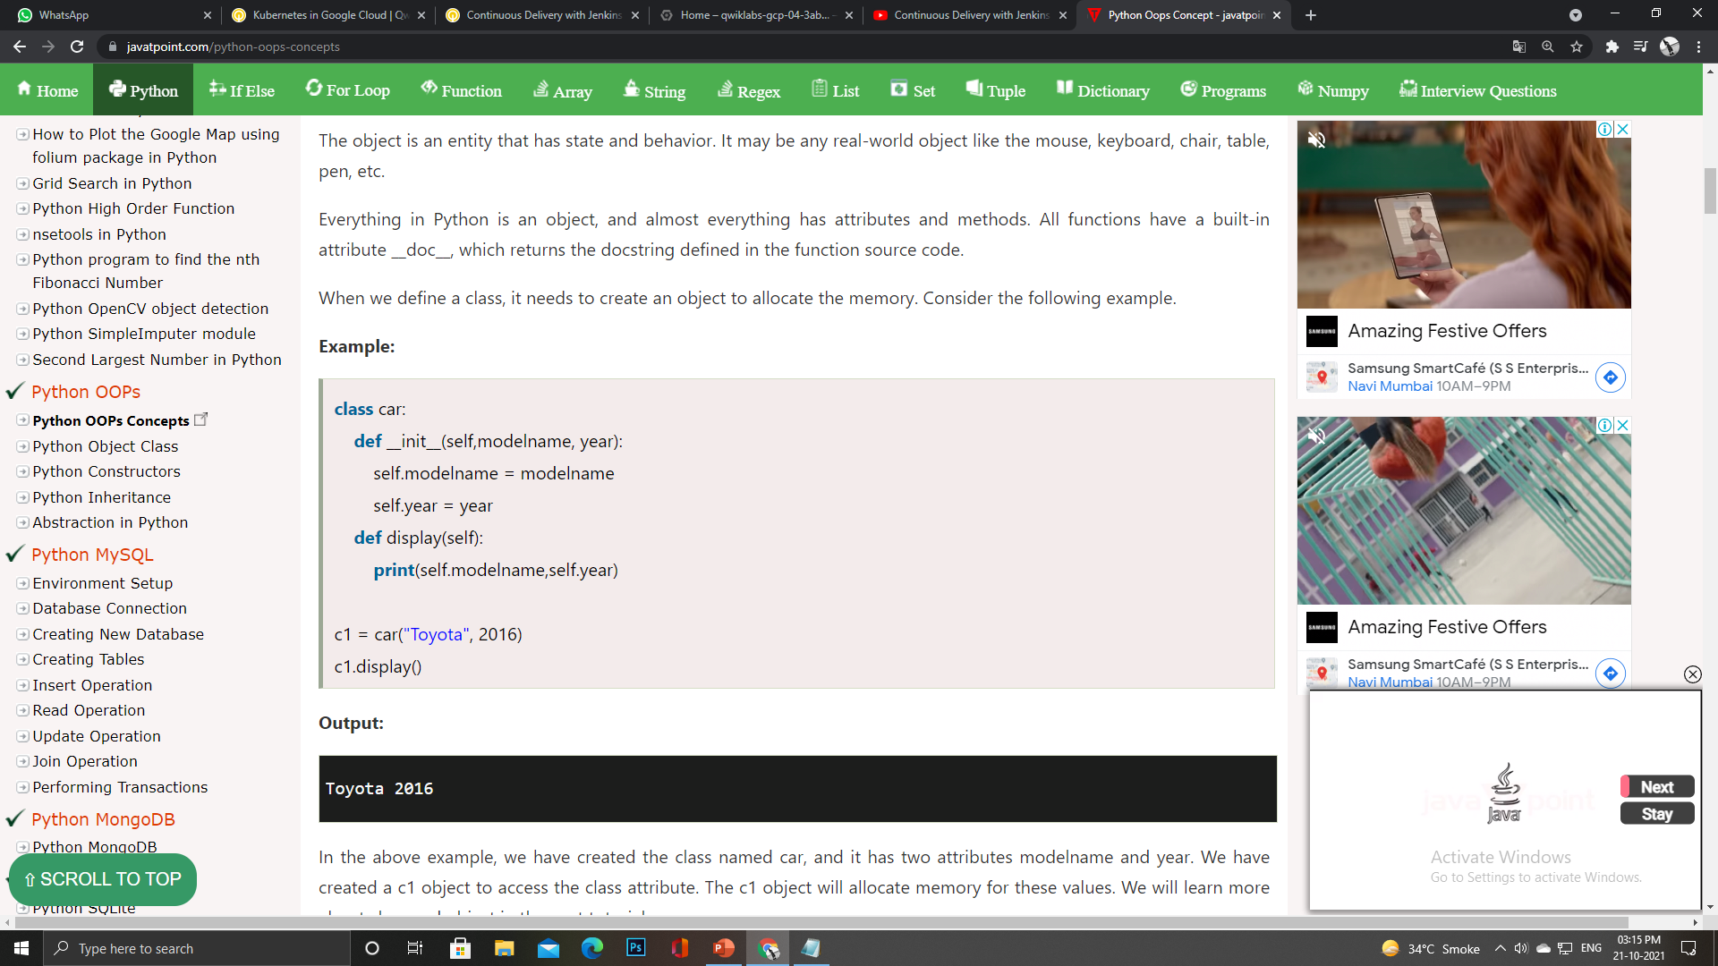
OOP in Python…
01. Class
Design or blueprint for the object
collection of objects.
logical entity that has some specific attributes and methods.
The __init__() function is called automatically every time the class is being used to create a new object.

Slide 19
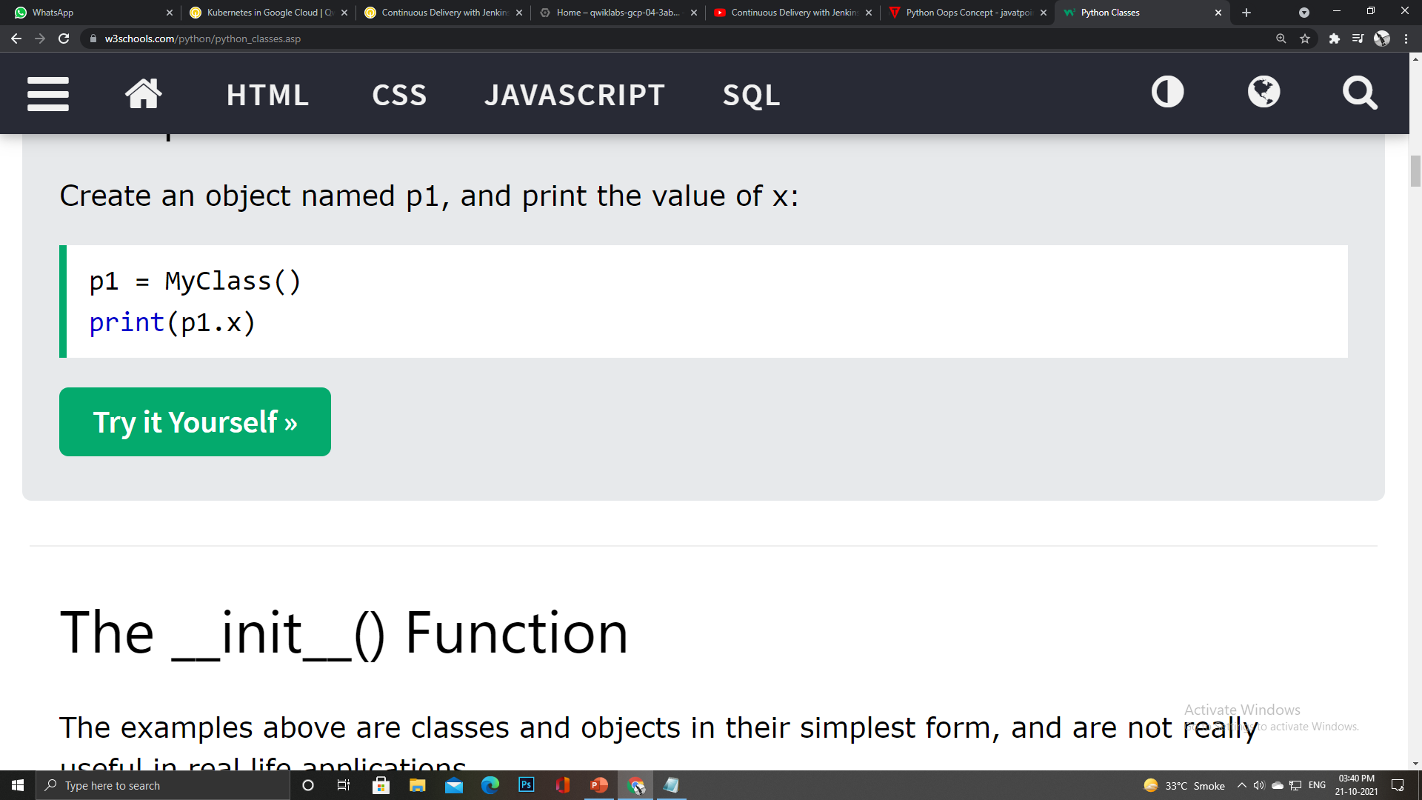
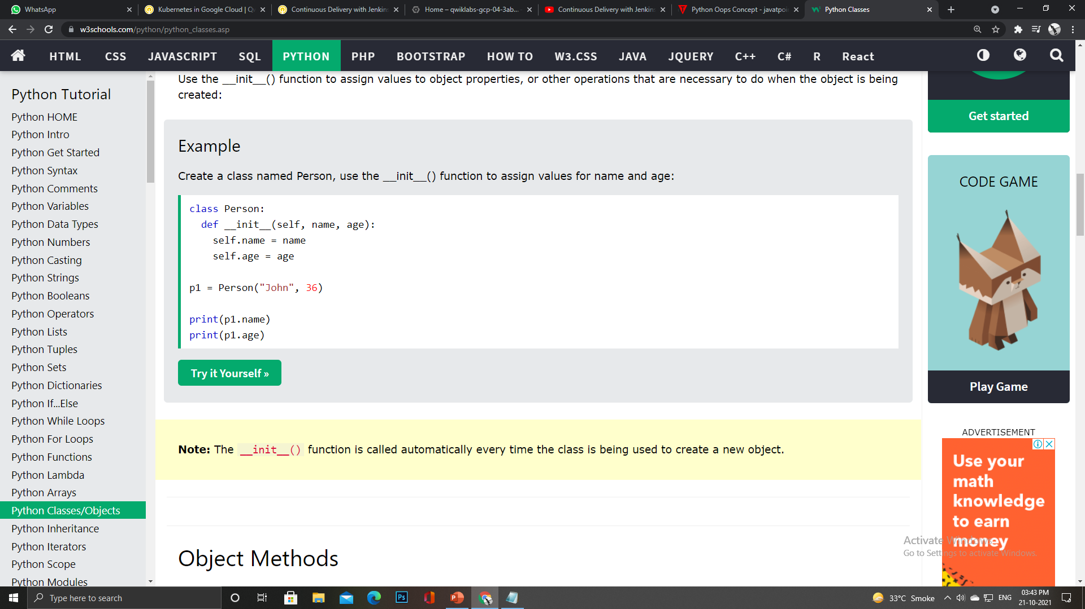
OOP in Python…
02. Object
The object is an entity that has state and behavior.
When we define a class, it needs to create an object to allocate the memory.
Everything in Python is an object, and almost everything has attributes and methods.

Slide 20
It does not have to be named self , you can call it whatever you like, but it has to be the first parameter of any function in the class:
OOP in Python…
The __init__() Function
Self Objects
All classes have a function called __init__(), which is always executed when the class is being initiated.
1. The self parameter is a reference to the current instance of the class, and is used to access variables that belong to the class.
2. The __init__() function is called automatically every time the class is being used to create a new object..
2. The self parameter is a reference to the current instance of the class, and is used to access variables that belong to the class.

Slide 21
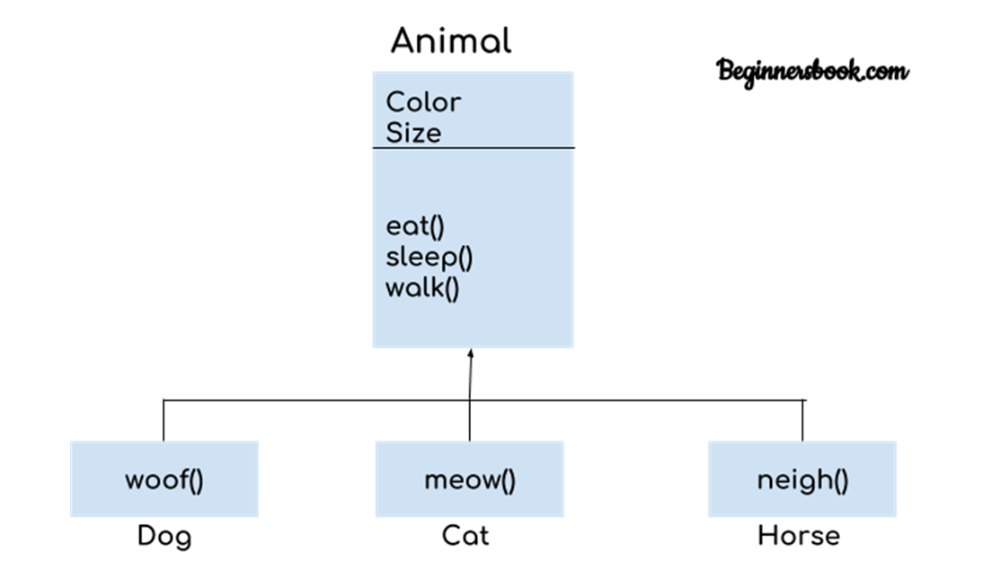
OOP in Python…
03. Inheritance
Inheritance allows us to define a class that inherits all the methods and properties from another class.
inherited from, also called base class.
Child class is the class that inherits from another class, also called derived class

Slide 22
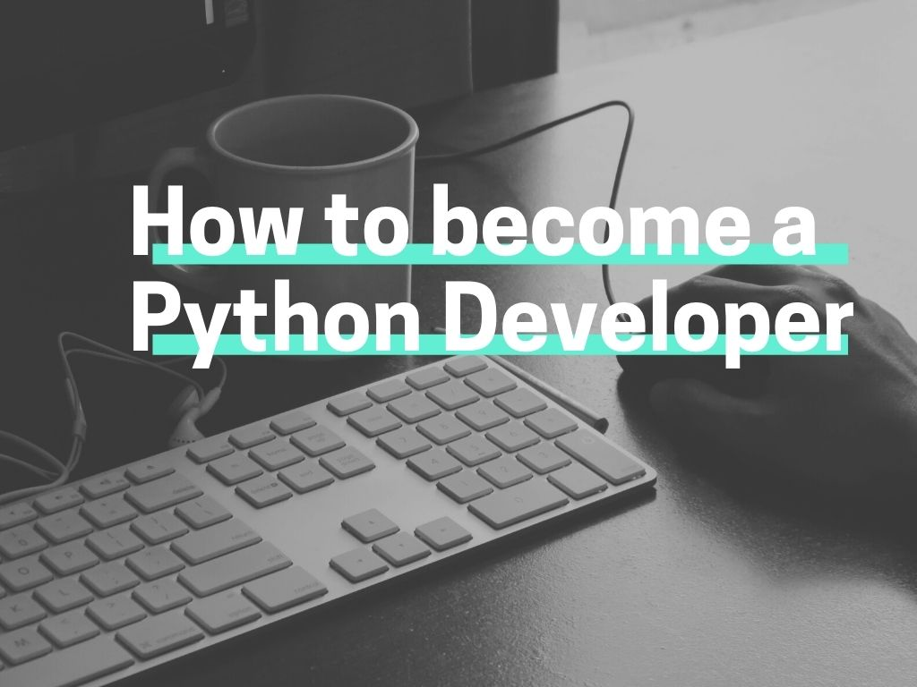

Slide 23

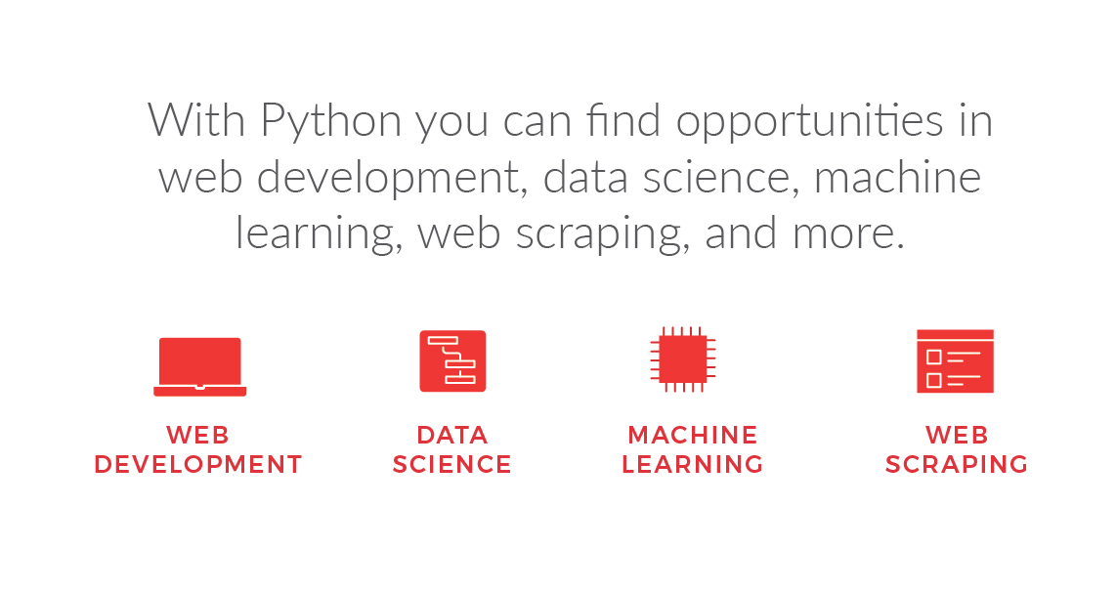

Slide 24


